Slide 1


Photon-Tagged beamline Summer Student Project
Gonzalo Morras

Slide 2
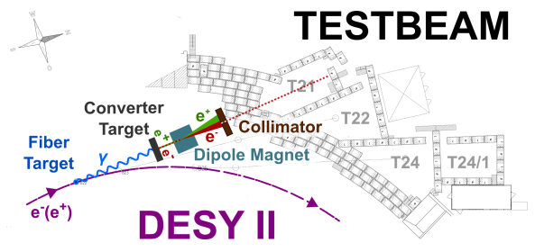
The testbeam facility

Slide 3
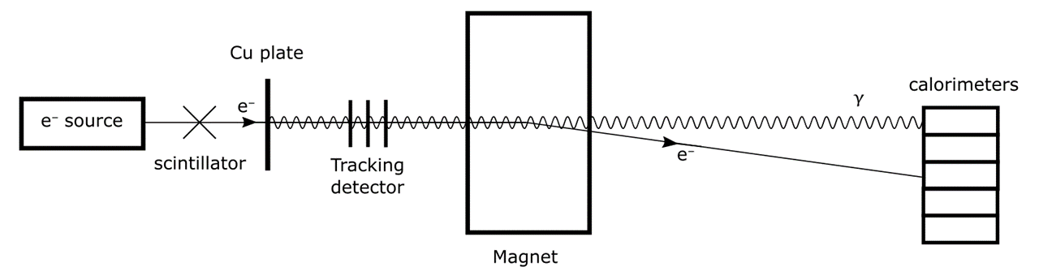
Photon tagged beamline
Proof of concept experiment.
Motivation: allows testbeam users to use photons of known energy.

Slide 4
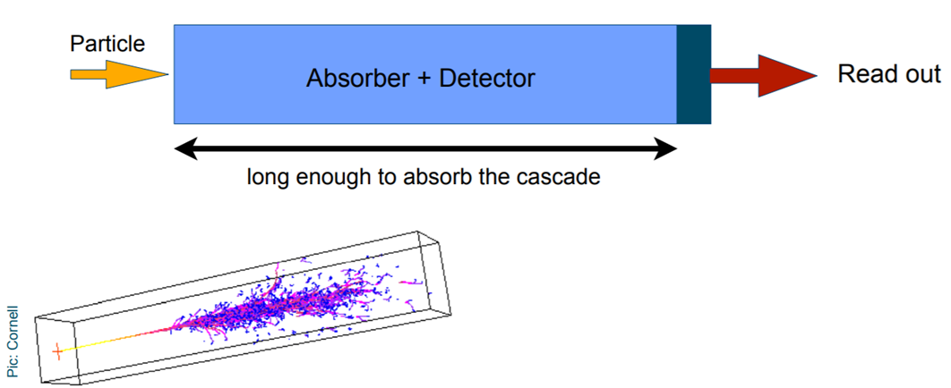
Calorimeters – Working principle

Slide 5
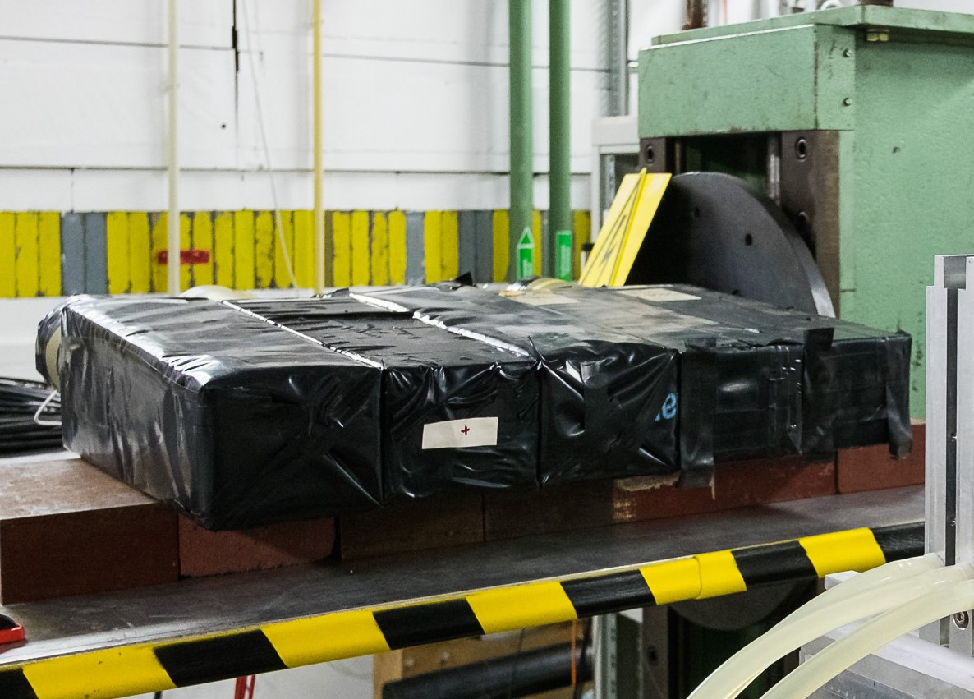
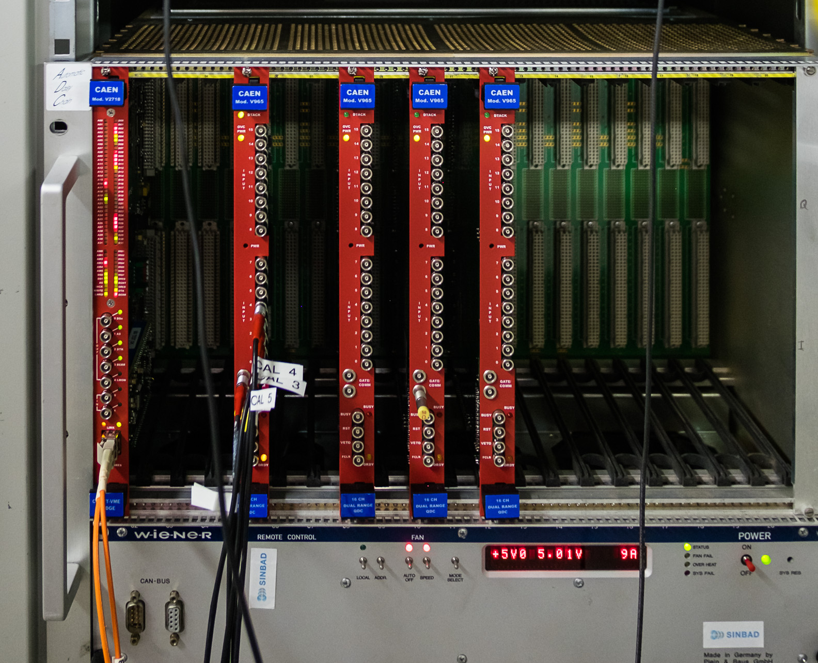
Calorimeter readout – QDC
QDC (Charge to digital converter)

Slide 6
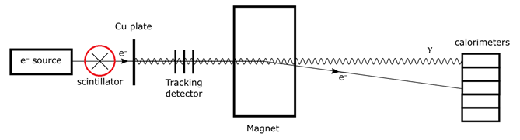
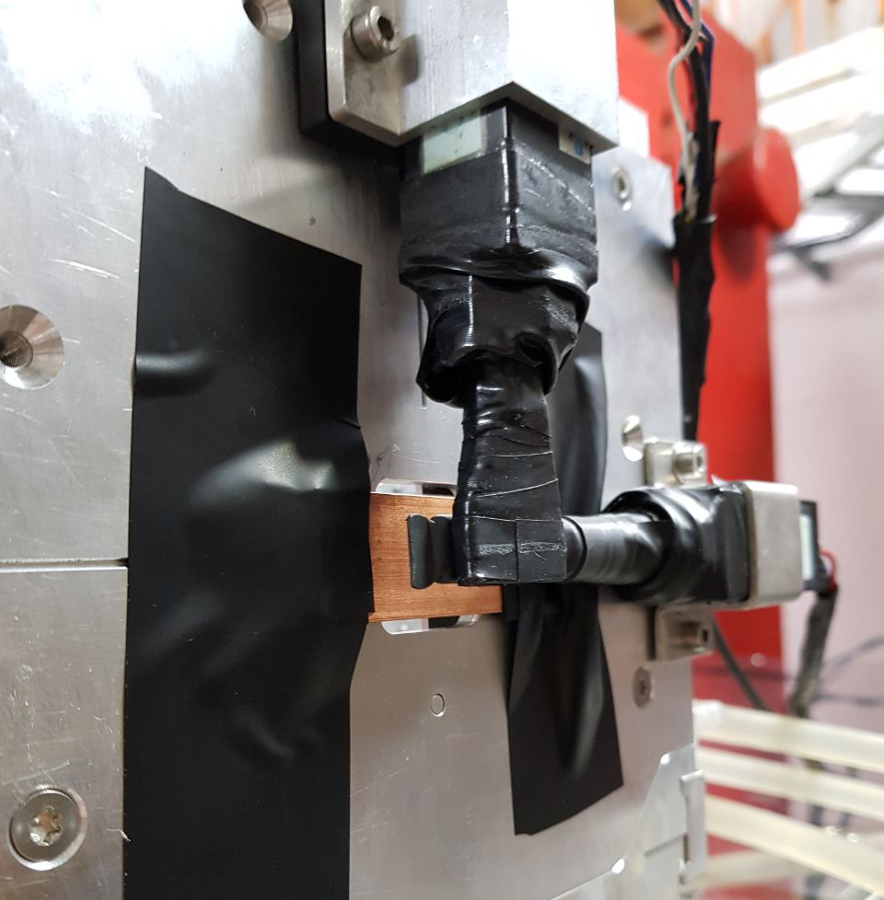
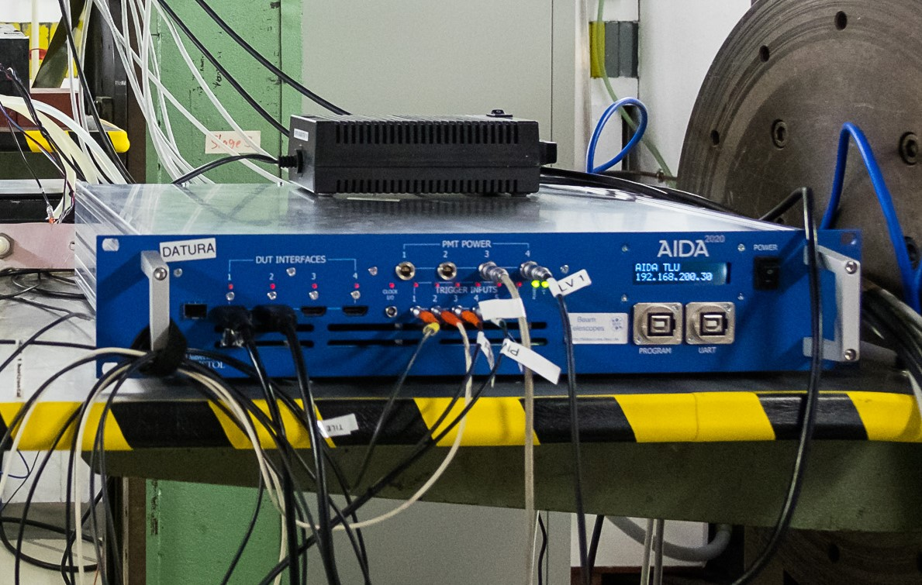
Triggering system
TLU (Trigger Logic Unit)
Copper target
Scintillators

Slide 7
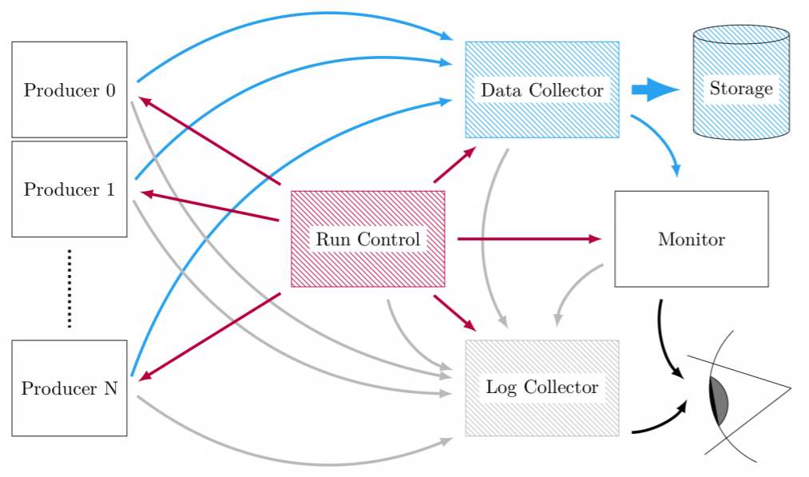
Data Acquisition System – EUDAQ

Slide 8
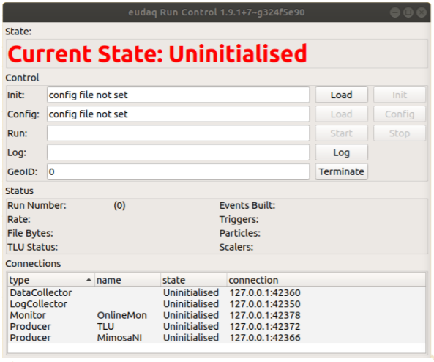
EUDAQ Run Control

Slide 9
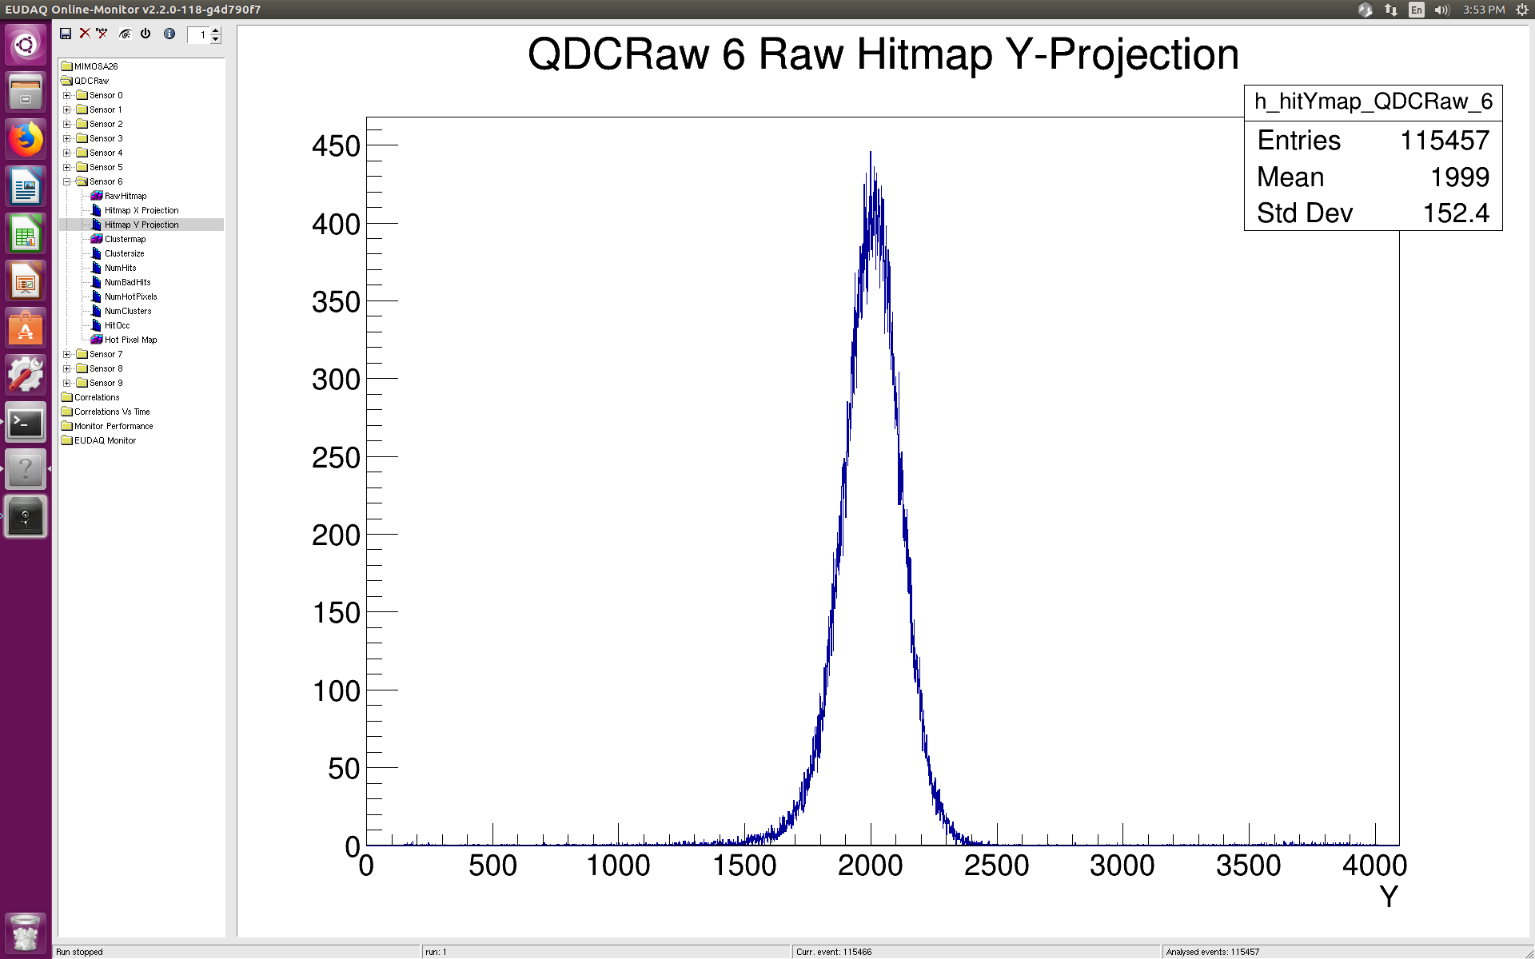
Real time data – EUDAQ Monitor

Slide 10
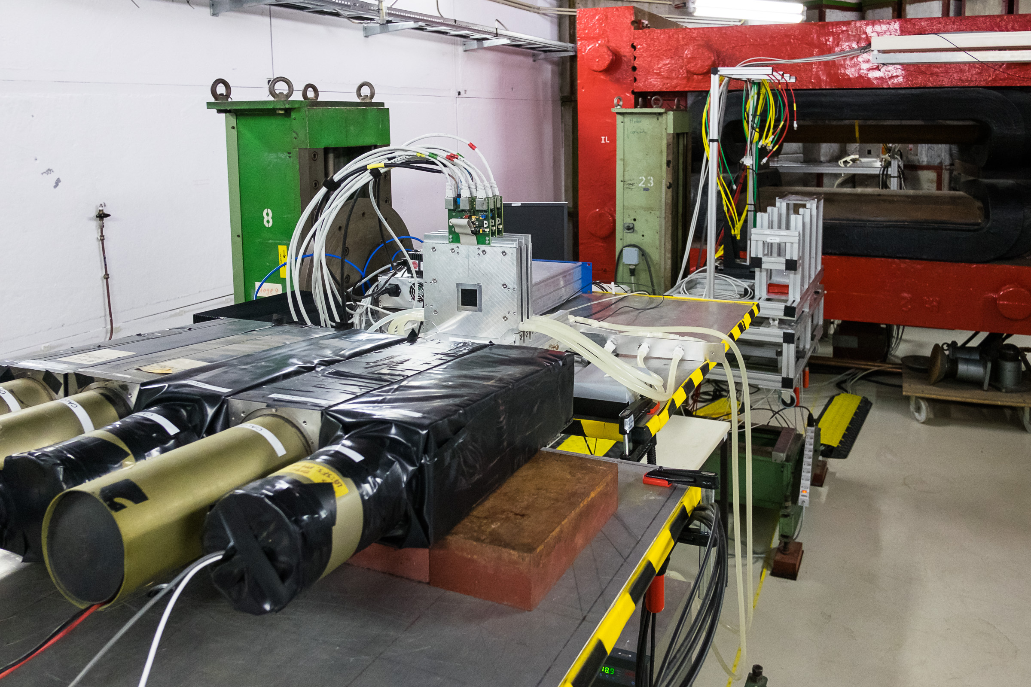
One week of setup and measurement in the testbeam

Slide 11
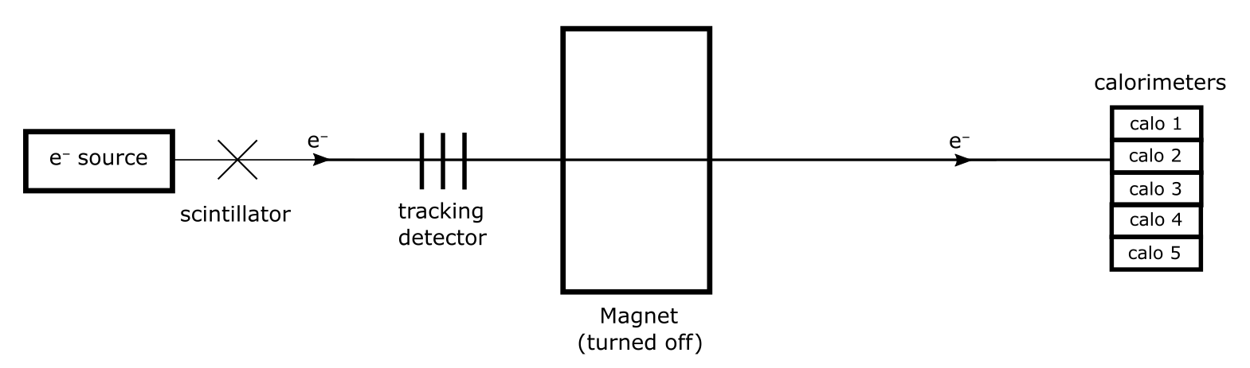
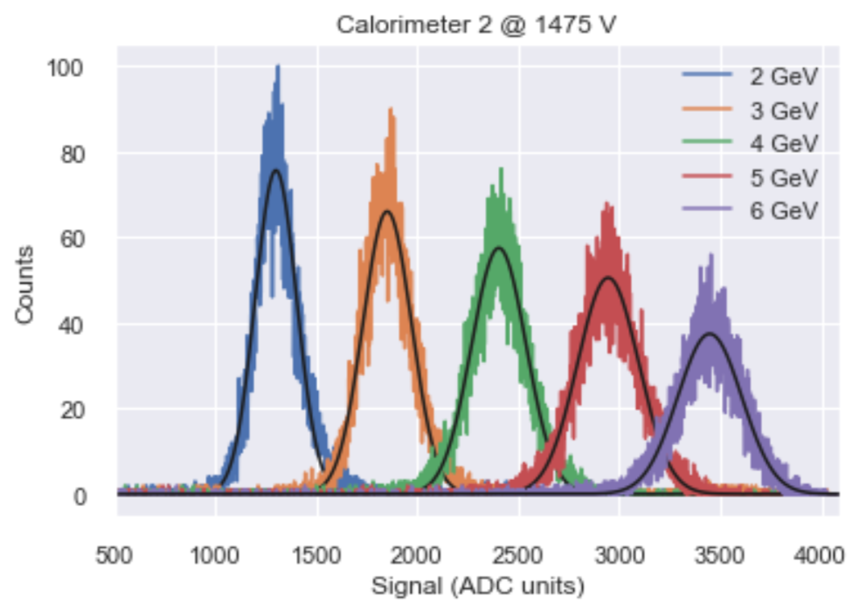
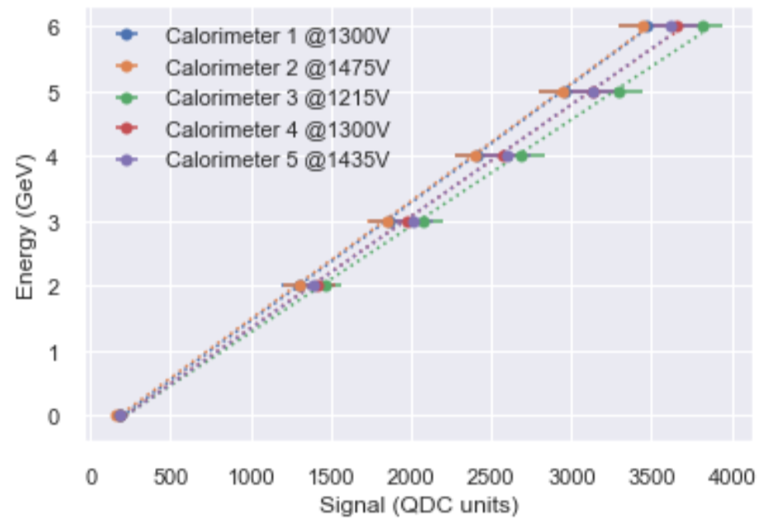
Calorimeter calibration

Slide 12
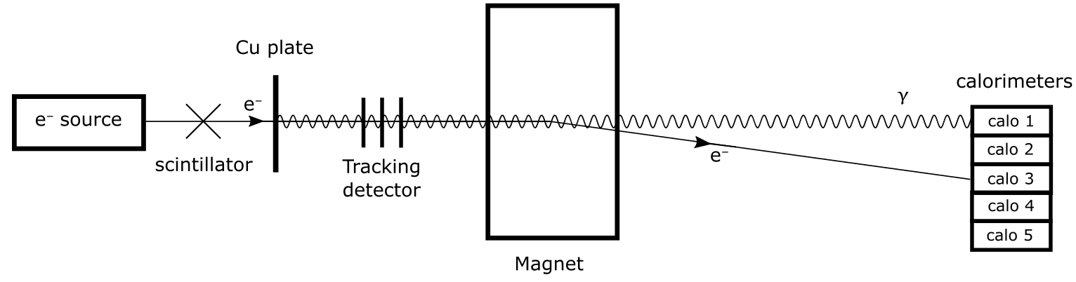
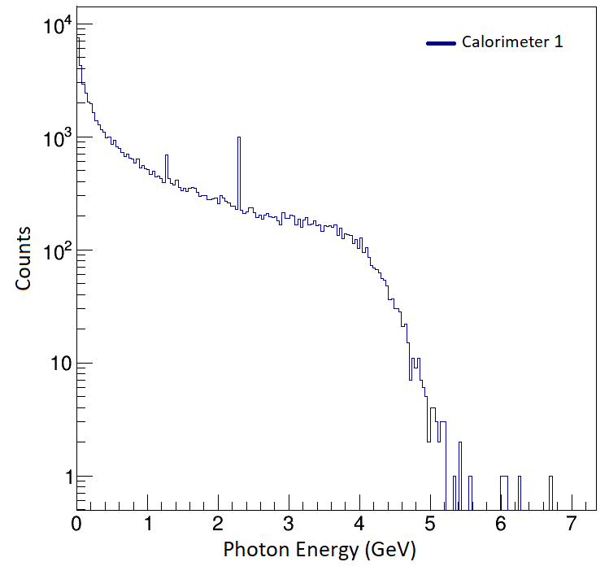
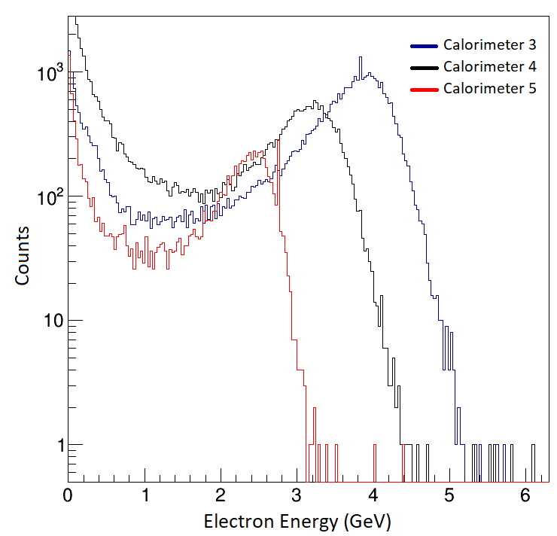
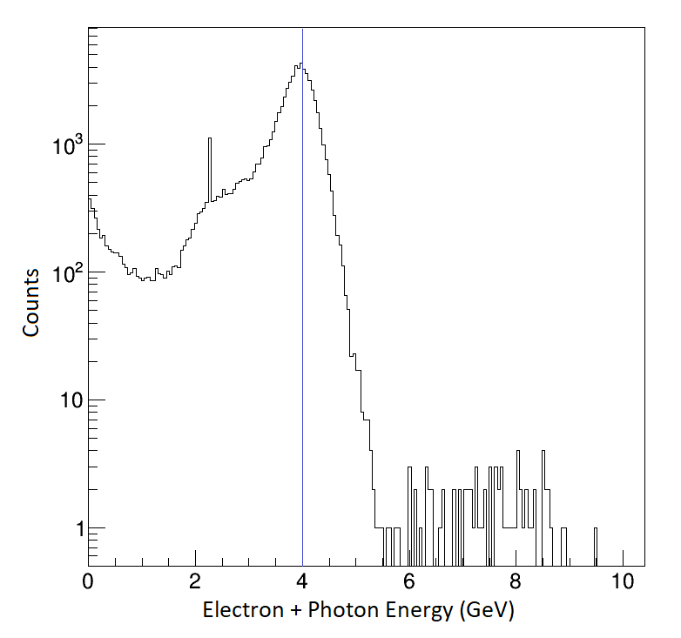
Measurement example E₀ = 4GeV

Slide 13
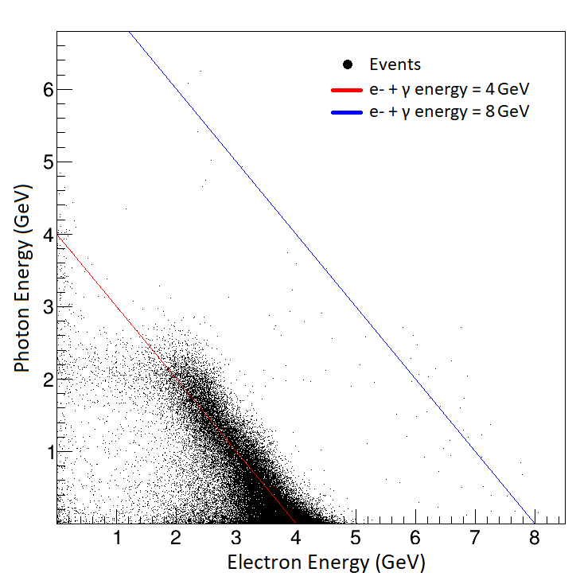
Measurement Example E₀ = 4 GeV

Slide 14
Summary and outlook
Integration of the calorimeters into the testbeam DAQ
Succesfull proof of concept of the photon tagged beamline setup

